Slide 1

Green Pace
Security Policy Presentation
Developer: Jason Restucci

Slide 2

OVERVIEW: DEFENSE IN DEPTH
The goal of this security policy is to set a collection of standards and best practices to maintain the safety of our software and data. It combines multiple security measures in a layered approach called “Defence in Depth”.

Slide 3
THREATS MATRIX
Likely INT36-C ERR51-CPP | Priority STR50-CPP FIO30-C INT32-C MEM52-CPP DCL30-C
Low priority EXP40-C INT50-CPP ERR06-C | Unlikely STD-001-CPP
Low Priority: Unlikely to happen with a low severity
Likely: Probable or likely to happen with a low severity
Unlikely: Unlikely to happen but with a high severity
Priority: Probable or likely to happen with a high severity

Slide 4
10 PRINCIPLES
1 | Validate Input Data | STR50-CPP
2 | Heed Compiler Warnings | INT36-C, INT50-CPP, MEM52-CPP, ERR51-CPP
3 | Architect and Design for Security Policies | FIO30-C
4 | Keep It Simple
5 | Default Deny
6 | Adhere to the Principle of Least Privilege
7 | Sanitize Data Sent to Other Systems
8 | Practice Defense in Depth
9 | Use Effective Quality Assurance Techniques | INT36-C, INT50-CPP, STR50-CPP, INT32-C, EXP40-C
10 | Adopt a Secure Coding Standard | FIO30-C, ERR06-C, DCL30-C, EXP40-C

Slide 5
CODING STANDARDS
1 | FIO30-C | Exclude user input from format strings
2 | STR50-CPP | Guarantee that storage for strings has sufficient space for character data and the null terminator
3 | INT32-C | Ensure that operations on signed integers do not result in overflow
4 | MEM52-CPP | Detect and handle memory allocation errors
5 | DCL30-C | Declare objects with appropriate storage durations
6 | INT36-C | Converting a pointer to an integer or integer to a pointer
7 | ERR51-CPP | Handle all exceptions
8 | EXP40-C | Do not modify constant objects
9 | INT50-CPP | Do not cast to an out-of-range enumeration value
10 | ERR06-C | Understand the termination behavior of assert() and abort()

Slide 6
ENCRYPTION POLICIES
Encryption at rest | Encryption at rest is the practice of encrypting data even when it is dormant and in storage. The idea is that if the storage itself is compromised, the data will be unreadable to anyone who lacks the key, providing an additional layer of security.
Encryption in flight | Encryption in flight is the practice of encrypting data while it is being sent to another system. This protects it against users trying to intercept the data during the process. The interceptor would not be able to access the information without a key.
Encryption in use | It is important to maintain security at all times. With the other two states encrypted that leaves data in use as the only weak point. Data in use must be encrypted to make sure all bases are covered.

Slide 7
TRIPLE-A POLICIES
Authentication | Authentication is the process of ensuring a user is who they say they are. This is usually through the use of a username, password, and possible security questions. The policy applies because it is imperative to security to ensure only the right users are entering the system, and they are a known quantity.
Authorization | Authorization is the process of ensuring all users have the correct level of access to the right systems and data. It is important for security that people who should not have access to certain information or systems do not, and people who should, do. Put simply, certain data/systems are too sensitive for just any user to access.
Accounting | Accounting is the process of keeping track of all activity of a user. This usually takes the form of logs tracking the actions of the user like the files accessed by the user, or user logins. If there is unusual activity or changes to the database or system, you need to be able to track that activity to a user. Additionally, this can be used to provide context for some bugs or other issues the system might be having.

Slide 8
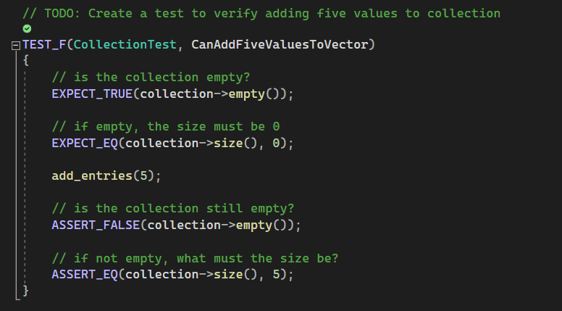
Unit Testing

Slide 9
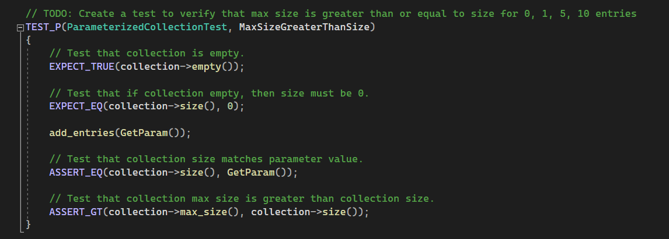
Unit Testing

Slide 10
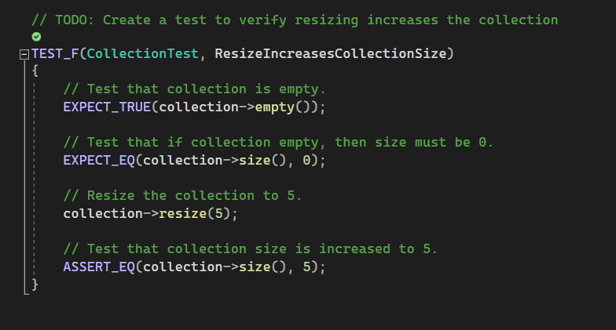
Unit Testing

Slide 11
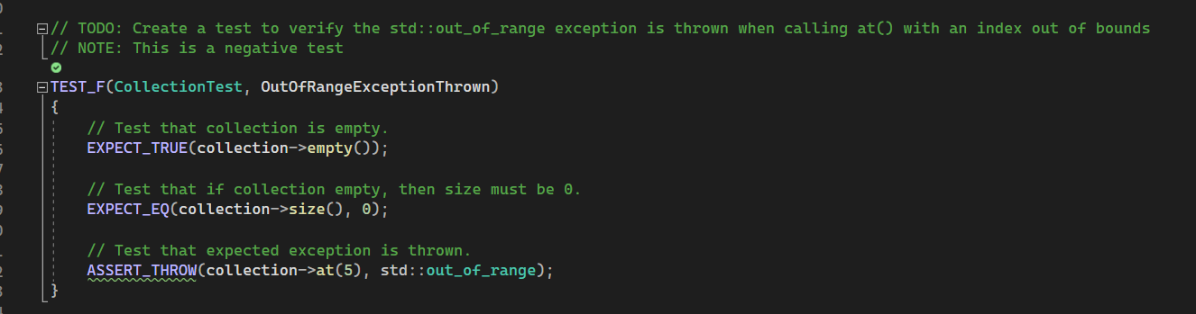
Unit Testing

Slide 12

AUTOMATION SUMMARY

Slide 13
TOOLS
The DevSecOps pipeline ensures security is baked into every part of the development process.
It is a roadmap of security operations for all stages of development.
The design stage utilizes OWASP to create a secure design
The build stage, and the “verify and test stage” will utilize and IDE like Visual Studio as well as its compiler, testing tools, and static analyses tools to create secure code.
The monitor and detect stage will use automated logging and event alerting tools to ensure security at all times post launch

Slide 14
RISKS AND BENEFITS
Benefits of acting early
Security is much easier to implement when incorporated from the start.
More reliable, and consistent code
With multiple layers of security, if one layer does not catch the threat, another most likely will
Risks of acting late
Upfront costs of dealing with problems already present
It is much more difficult to add security to a system after it is already designed or build.
Code will most likely not be secure and would need to be fixed

Slide 15
RECOMMENDATIONS
Additional and regular security training for developers
More automation to speed up development time

Slide 16
CONCLUSIONS
Security should be integrated from the start of the project.
Initial and regular security training should be provided for the developers.
Checks should be in place to ensure security policies are being met, throughout development.
The security policy should be reviewed and updated as necessary, at regular intervals.

Slide 17
REFERENCES
SEI CERT C++ Coding Standard - SEI CERT C++ Coding Standard - Confluence. (n.d.). https://wiki.sei.cmu.edu/confluence/pages/viewpage. action?pageId=88046682
OWASP. (n.d.). Principles of security. OWASP Developer Guide | Principles of Security | OWASP Foundation. https://owasp.org/www-project-developer-guide/draft/foundations/security_principles/

